Slide 1


Dialysis of Patients

Slide 2

Our Team (GRoup-6)
Neelofar B Korabu
Gauri Mendhe
Uma Neelkant Manta
Hitesh Kisan Shirbhate
Aman Vinod Gupta

Slide 3
Table of contents
Introduction
Number of Patients across various summaries
Profit Vs Non-Profit Stats
Chain Organizations w.r.t. Total Performance Score as No Score
Dialysis Stations Stats
# of Category Text - As Expected
Average Payment Reduction Rate
KPI Analysis
Dashboard
Excel Dashboard
Tableau Dashboard
Powerbi Dashboard

Slide 4
Introduction
Dialysis healthcare analytics gives the analysis of Key Performance Indicators[KPIs] to gain insights and make data driven decisions in the field of dialysis care.
It consists of monitoring the number of patients across various summaries, comparing profit and non-profit statistics, gives the count of chain organizations with respect to total performance as no score, analysing dialysis station statistics, examining category text for as expected outcomes and calculating the average of payment reduction rate.

Slide 5
KPI Analysis
1.Number of Patients across various summaries
This KPI analyses the Number of patients across various summaries which involves tracking of 13 summaries which gives the sum of each summary out of which the highest total number of patient across each summary is number of patient-months in serum phosphorus summary.
This KPI insights can be used to analyse the demand for dialysis services which helps in tracking the patient population trends and thus assists healthcare providers in giving personalized care for particular patient based on their condition

Slide 6
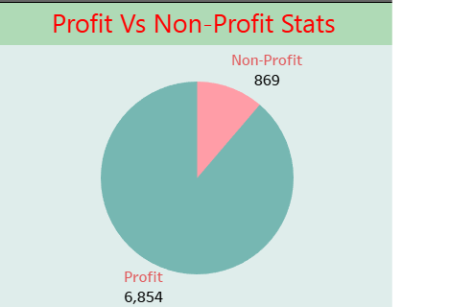
KPI Analysis
2. Profit Vs Non-Profit Stats
This KPI helps us to analyse the financial metrics w.r.t Profit and Non-Profit organizations which plays an important role in dialysis of healthcare analytics.
It helps to identify the differences between profit and non-profit organizations which helps the stakeholders to make a decisions regarding cost of resources, cost management and care.

Slide 7
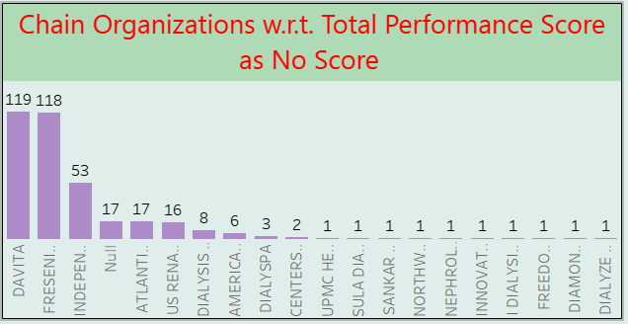
KPI Analysis
3.Chain Organizations w.r.t. Total Performance Score as No Score
This KPI gives the Count of Total performance score as No Score with respect to Chain organizations.
The total performance score outlines the efficiency through various quality measures , patient outcomes.
By analysing the chain organizations w.r.t total performance score as no score , the department of healthcare can identify the areas of improvement, and can promote good care delivery across each organizations.

Slide 8
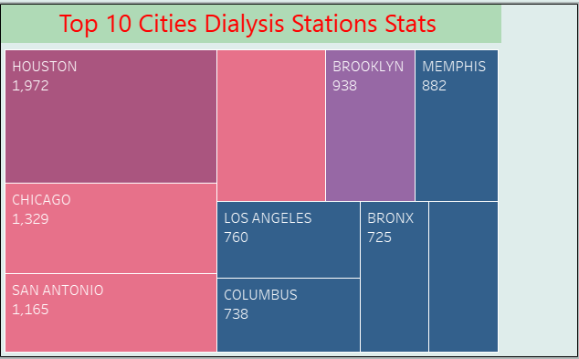
KPI Analysis
4. Dialysis Stations Stats
This KPI gives the top 10 cities with respect to sum of Dialysis Stations across all fields.
This helps us to survey the number of dialysis stations, their efficiency of operations, and availability.
By analysing these stations ,the healthcare department can develop understanding of areas of underutilization and can improve the efficiency in delivering care.

Slide 9
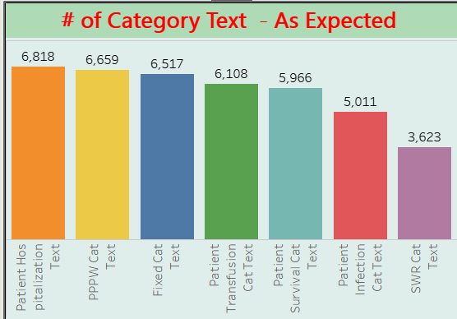
KPI Analysis
5. # of Category Text – As Expected
This KPI represents the count of all 6 categories with respect to As Expected as text.
This analysis helps hospitals to prioritize and concentrate on the services which are provided to the patients based on the category they are allotted.
By comparing these outcomes, the healthcare contributor can identify the treatment plans , patterns and provide the better care to specific patient of each category.

Slide 10
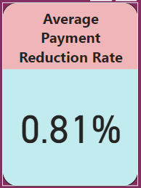
KPI Analysis
6. Average Payment Reduction Rate
This KPI gives the average of Payment Reduction Rate.
The hospitals and healthcare suppliers can analyze their financial status and plan strategies for their revenue.
On this basis hospitalization costs and total expenditures for dialysis patients can be fixed.

Slide 11
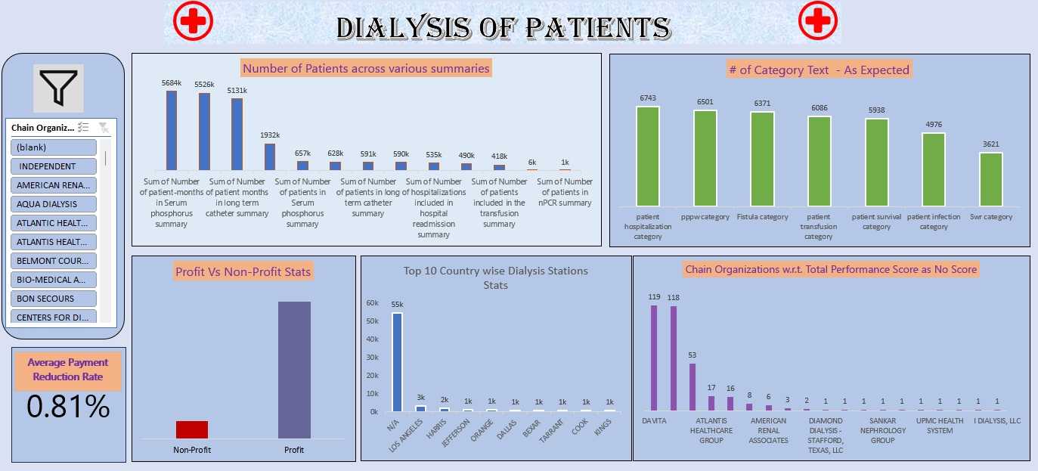
Excel Dashboard

Slide 12
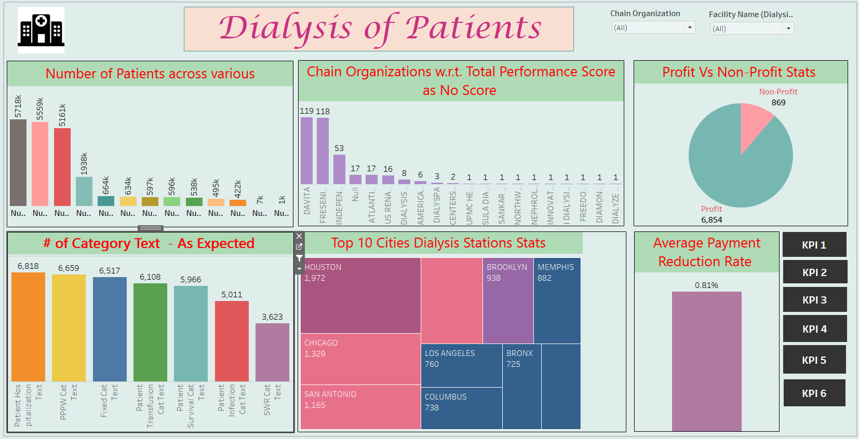
Tableau Dashboard

Slide 13
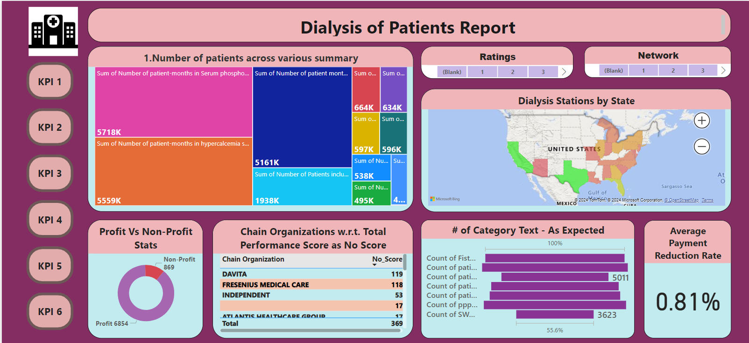
Power bi Dashboard

Slide 14
Conclusion
The Dialysis of Patient Analysis project provides valuable insights of patients with respect to fields.
The analysis of these KPIs helps in identifying areas of improvement and enhance financial performance.
As a data analyst, We have used Excel, MySQL, Tableau and Power BI to clean and manipulate the dataset and create meaningful visualizations.
This project serves as a great example of how data analysis can help hospitals make informed decisions.

Slide 15

Thank you

